Slide 1

By: Brian Hert, Dhruv Sharma, Richard Clinger, & Prabhash Venkat Paila
Data Preprocessing and Analysis on Heart Disease Dataset

Slide 2
Introduction
In this project, we took a look at heart disease dataset, preprocessed it and trained our model with the dataset. This Report outlines the Preprocessing techniques that were applied, the effects of data preprocessing, and how we trained and tested our model with the dataset.

Slide 3
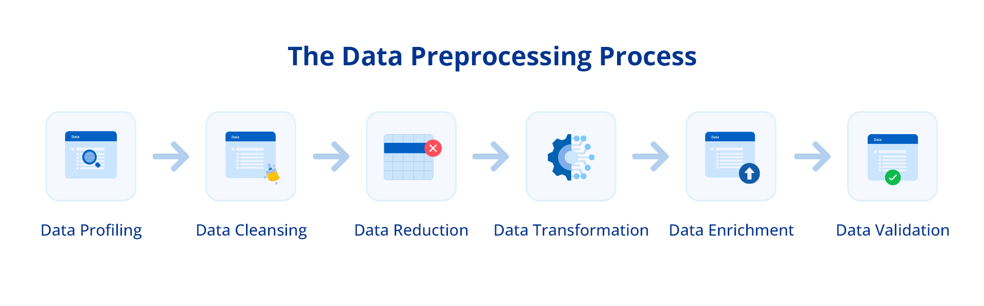
Preprocessing Techniques
Duplicate Removal
Handles missing values with NaN
Outlier detection and removal
Feature Encoding using LabelEncoder and One-hot Encoding
Feature scaling by normalizing data using z score (standard scalar)

Slide 4
Preprocessing Order and Importance
Duplicate Removal: to endure there are no repeating rows in the dataset a
Handling Missing Values: to avoid issues with the models training
Outlier Removal: To reduce the influence of extreme values
Encoding Categorical Variables: Converts categories into numerical values
Feature Scaling: Z score to bring features to a similar range

Slide 5
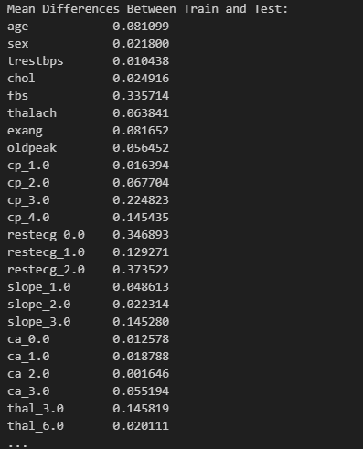
Dataset Splitting and Comparison
80-20 Split of the Dataset: 80% on training and 20% on testing using the train_test_split function, which helps prevent overfitting
Comparing Train and Test Sets: Presents the differences in the mean and standard deviations of features between the training and the test set, to highlight whether the model needs more training or not

Slide 6
Imbalanced Dataset Handling
There was no significant imbalance in the dataset, even with features like sex. This was because the categories were evenly split. However in future datasets, where one gender might be more than another, we may need to resample or adjust the weights in our model.

Slide 7
Conclusion
This projects pipeline applies several preprocessing techniques in order to prepare the dataset for machine learning and training the mode. Despite some differences between the train and the test, the differences are pretty low and the dataset is well balanced

